Slide 1
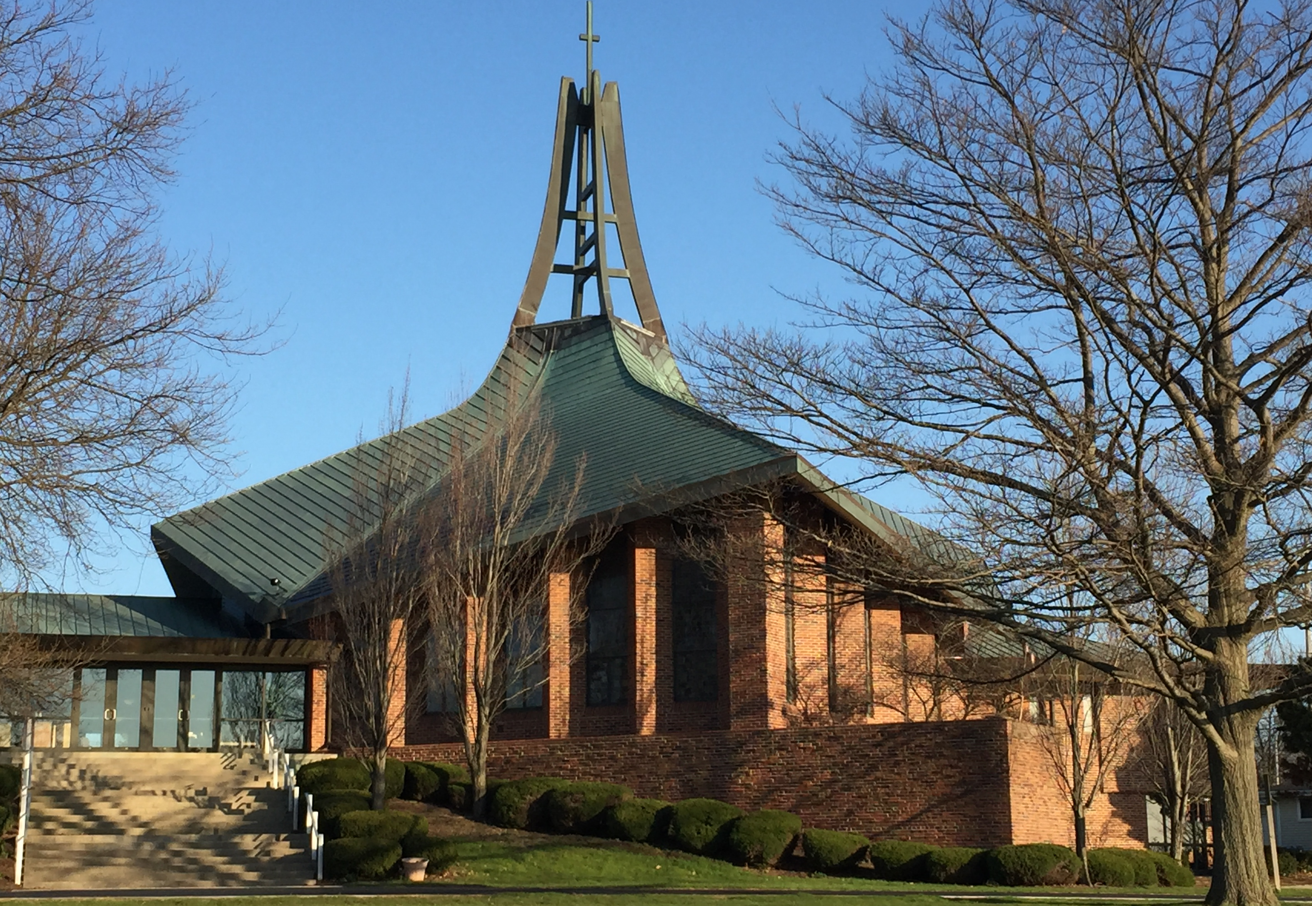

The Path Forward
Presentation to Our Congregation
Sunday, May 29, 2016 & Sunday, June 5, 2016

Slide 2
Our Journey Continues …
Worship
Consolidated three Sunday services to two - retaining traditional & contemporary worship settings;
Hiring of Jim Sodke for Traditional Worship;
Continuing contemporary worship with the Revelation Band;
Weekly serving of communion
Education, Spiritual Growth and Support
Pastor Arthur’s education offerings;
Janice’s ongoing education offerings;
Seniors monthly Bible study;
Youth Ministry;
For All: Electronic Prayer Chain — 10% of all LCR members now pray for others in need;
For All: Payoff of Mortgage

Slide 3
Our Journey Continues …
Communication & Community Outreach
Membership that serves the poor;
New LCR website - went “live” in late March;
LCR Facebook page;
Developing a consistent LCR internal and external branding;
God’s Work, Our Hands - LCR hosted this Racine ELCA community event last September
Building Our Ministries Through People - Our Rostered Leaders
Rev. Dr. Arthur Bergren - Lead Pastor;
Janice Navarro - Associate in Ministry;
Rev. Dr. Melvin Miritz - Pastor Emeritus
Building Our Ministries Through People - Our Directors
Dori Rossmann - Director of Youth Ministry;
Jerry Tapp - Director of Communications;
Jim Sodke - Director of Traditional Worship, also serves as our organist;
Lynette Jacobson - Director of Contemporary Worship

Slide 4
Our Journey Continues …
Building Our Ministries Through People - Our Musicians
Jack Senzig - Choir Director and our LCR Choir;
JoAnn Nelson - Flutist;
The Revelation Band
  Jim Bednark;
  DeeAnn Bliss, also serves as our youth choir director;
  Jim Kunka;
  Herk Wanggaard, also serves as our sound technician;
  Lynette Jacobson;
  Fred Jacobson;
  Paul Dry;
Nicki D’Amour - Pianist (Saturday Evening Service);
Kristi Fenkl - Cantor (Saturday Evening Service);
Chuck Petrach - Projectionist
Building Our Ministries Through People - Our Administrative Staff
Debbie Toff - Parish Secretary;
Kim Saunders - Financial Secretary;
Joe Colletta - Lead Custodian;
Del Alton - Custodian;
Rebecca Arreola - Custodian

Slide 5
Our Journey Continues …
STRENGTHS … that we can leverage
Core of strong and active members;
Facility, location and acreage of LCR;
Membership understands congregation as family;
New direction;
Diversity of worship experiences: informal, traditional and contemporary;
Youth program;
Mortgage paid off;
Strongest ELCA parish in Racine
WEAKNESSES … that we can remedy
Declining Sunday School attendance in younger grades;
Few new members and young families;
Inaccurate numbers for members and workshop attendance;
No church-wide outreach to unchurched and de-churched;
Plateaued income;
Two congregations: traditional and contemporary;
Poor internal and external communications;
Aging facility

Slide 6
Our Journey Continues …
OPPORTUNITIES … that we can choose and pursue
Evangelism, outreach, hospitality strategy;
Communication strategy;
Integrate the gifts and skills of all members;
Deepen program ministry: education, fellowship justice, spirituality;
Congregational history of risk taking:
  Formation of parish and addition of contemporary worship
THREATS … that we can mitigate
Vulnerability due to aging donor base and giving patterns;
Failure of membership to understand the current state of affairs at LCR;
Inability to embrace an outreach culture at LCR;
Failure to evolve into a proactive organization;
Staff transition

Slide 7
Our Journey Continues …
…”LCR’s threats include financial vulnerability due to an aging donor base and giving patterns, failure of membership to understand the current state of affairs at LCR, inability to embrace an outreach culture at LCR, failure to evolve LCR into a proactive organization and staff transition. We have been able to further define the financial vulnerability based on 2015 giving. In 2015, 50% of our annual giving comes from members who are 75 years of age and older.” …
… “Leadership’s responsibility is to retain the best practices of LCR, while addressing the threats to the very best of our ability. I have every confidence we will do so for the glory of God.” …
—Rev. Dr. Arthur Bergren, Annual Report of the Lead Pastor, 2015 LCR Annual Report, January 31, 2016

Slide 8
General Envelope Giving Trends … A Five Year History
-6.6% / -$36.0 Over Five Years

Slide 9
Congregation Giving … An Uninformed View
General Envelope Giving
 | 2016 | 2017 | 2018 | 2019 | 2020 | 2021
No Growth | $536.1 | $536.1 | $536.1 | $536.1 | $536.1 | $536.1
1% |  | $541.5 | $546.9 | $552.3 | $557.9 | $563.4

Slide 10
General Envelope Giving for 2015 … by Age Group
Age Group | Units | $ Given | % Total
<60 | 168 | $142.5 | 28%
60 - 74 | 74 | $106.5 | 21%
75+ | 63 | $258.9 | 51%
Total | 305 | $507.9 | 100%

Slide 11
General Envelope Giving for 2015 … a Further Look
Age Group | Units | $ Given | % Total
<60 | 168 | $142.5 | 28%
60 - 74 | 74 | $106.5 | 21%
75+ (<$5.2k) | 57 | $84.1 | 17%
75+ (>$5.2k) | 6 | $174.8 | 34%
Total | 305 | $507.9 | 100%

Slide 12
Changes in Income … by Annual Giving Bracket
Giving Bracket |  | 2012 | 2015 | Change | % Change
$1 to $1,560 per year $1 to $30 per week | Units | 300 | 222 | (78) | (26.0%)
 | $ | $138.1 | $96.0 | ($42.1) | (30.5%)
$1,560 to $5,200 per year $30 to $100 per week | Units | 71 | 72 | 1 | 1.4%
 | $ | $179.7 | $196.8 | $17.1 | 9.5%
$5,200+ per year $100+ per week | Units | 16 | 11 | (5) | (31.3%)
 | $ | $229.9 | $215.1 | ($14.8) | (6.4%)

Slide 13
Congregation Giving … An Informed View
 | 2016 | 2017 | 2018 | 2019 | 2020 | 2021
No Growth | $536.1 | $536.1 | $536.1 | $536.1 | $536.1 | $536.1
1.0% |  | $541.5 | $546.9 | $552.3 | $557.9 | $563.4
Estimated Aging Impact |  | ($28.9) | ($47.0) | ($84.5) | ($122.4) | ($163.0)
Projected GE Giving |  | $512.6 | $499.9 | $467.8 | $435.5 | $400.4
We have to make provisions for this
ELCA data indicates that 11% of all congregations report undesignated giving of $400k or more.
Growth is for each year. Combination of giving and congregation growth.

Slide 14
Our Journey Continues … Our Opportunities, Our Faith and Receiving God’s Grace
Evangelism Ministries
New website up and running;
30 second rule;
Greeters;
Bring a friend Sunday
Outreach Ministries
Supporting our worldwide and community commitment to God’s children in need;
Ten percent of LCR’s annual general envelope income is directed for benevolent distribution
Stewardship Ministries
Our fall stewardship program;
Planning the financial gifts we receive for our 2017 ministries
LCR Building
Lighting cost reductions;
Heating and cooling assessment

Slide 15
Our Journey Continues … Our Opportunities, Our Faith and Receiving God’s Grace
For Every Member
Pray for good solutions and for our leaders;
Stay current or grow in your financial gifts to LCR;
Be faithful stewards of God’s gifts …
  by making stewardship part of your (daily) family conversation;
  by participating in our fall stewardship program;
  by offering your time and skills to the outreach, education and worship activities at LCR

Slide 16
A Personal Perspective
Jay Weiss
Rev. Dr. Arthur Bergren

Slide 17
Our Journey Continues … Our Blessings Build Our Future
Our blessings of abundance
Our blessings of a legacy of generosity
Our blessings of opportunity

Slide 18
Your Questions

